Slide 1
Warm-Up 5/4/2016 ( Write Q &A)
1) Who determines what is made and what is sold in a Command Economy?
2) Who determine what is made and what is sold in a Market Economy?
3) What was the difference between the United States government and the Soviet Union Governments?

Slide 2
2nd Period 5/4/2016
Group A
Group B
You will go to Millersworldhistory.weebly.com→ Unit 7→ Cold War Presentation and Take notes on the Presentation.
You will watch 5 minutes of the youtube video.
You will then complete the Webquest online.
You will take your test and then you will,
Then you will start on the webquest.
Webquest: Millersworldhistory.weebly.com→ Unit 7→ Cold War Webquest.
You will only answer the questions on your Webquest sheet ( Except #5)

Slide 3
The Cold War

Slide 4
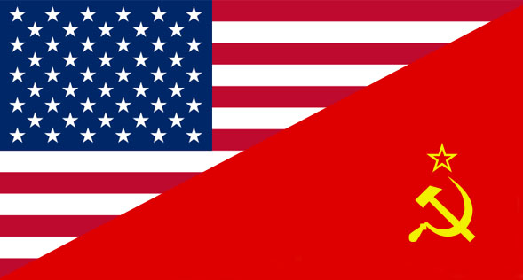
What was the Cold War
The Cold War was an indirect conflict between the United States and the Soviet Union. The United States was trying to spread Democracy while the Soviet Union tried to spread communism.

Slide 5
The Two Sides belief
America
Soviet Union
Wanted people to follow capitalism( Market Economy)
Free markets( Supply/Demand) runs the economy
They wanted people to be able to vote for their leaders
Wanted people to follow communism(Command Economy)
Government run the economy and determine what is sold.
They wanted them to have leaders that had control over the people.
Both competed against each other to have the largest nuclear armament/

Slide 6
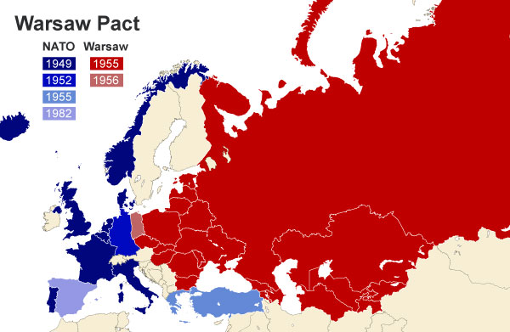
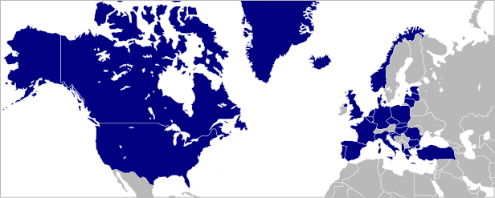
Cold War: A World Divided
NATO
Warsaw Pact
NATO: alliance of Western democracies
Warsaw Pact: alliance of the Soviet Union and its satellite nations

Slide 7
Cold War Webquest
Millersworldhistory.weebly.com→More→ Unit 7→ Cold War Webquest.
Complete the Webquest individually.
Do not do number 5

Slide 8
Collapse of Communism
USSR Collapsed in 1989 due to several reasons.
Life in USSR and Eastern Satellite States was harsh due to inefficient economic system.
Perestroika and Glasnot ( openness) allowed for more economic and political freedom for Soviet citizens.
USSR failure to stop revolutions against communism in Eastern Europe.

Slide 9
Cold War Explained.
If you had to take these notes on your own. Watch the following video to get a better idea of what the cold war is about. The video will run 5 minutes.
https://www.youtube.com/watch?v=d-_ldSDwLxw

